Slide 1


Exploiting the past to inform the future of clinical outcome assessment
Joseph T. Giacino, PhD
PI: Geoff Manley, MD, PhD
Outcomes Core Lead: Michael McCrea, PhD
Co-Leads: Murray Stein, MD, Joseph Giacino, PhD, Harvey Levin, PhD, Sureyya Dikmen, PhD, John Whyte, MD, PhD
(DoD CDMRP Award# W81XWH-14-2-0176)
Department of Physical Medicine & Rehabilitation
Harvard Medical School
Spaulding Rehabilitation Hospital
Massachusetts General Hospital
Brigham & Women’s Hospital

Slide 2
Current State of the Science
Interventional trials in acute TBI management have been uniformly disappointing:
TBI classification crude: Mild, moderate, severe (GCS)
Outcome assessment equally crude: Dead, VS, lower severe, upper sev, low moderate, upper mod, good recovery (GOS-E)
Studies underpowered, non-standardized procedures, limited multidisciplinary collaboration.
No COAs or biomarkers have been validated or qualified for TBI.
Consequence: Inability to preferentially target therapies to patients with specific injury mechanisms.

Slide 3
The Future of TBI Research
To enhance the effectiveness of TBI research, we need clinical outcome assessment measures (COAs) and biomakers that:
1) Permit more accurate disease/condition diagnosis
2) Identify distinct patient subpopulations likely to benefit
from therapy/intervention
3) Provide precise outcome assessments to confirm efficacy.

Slide 4
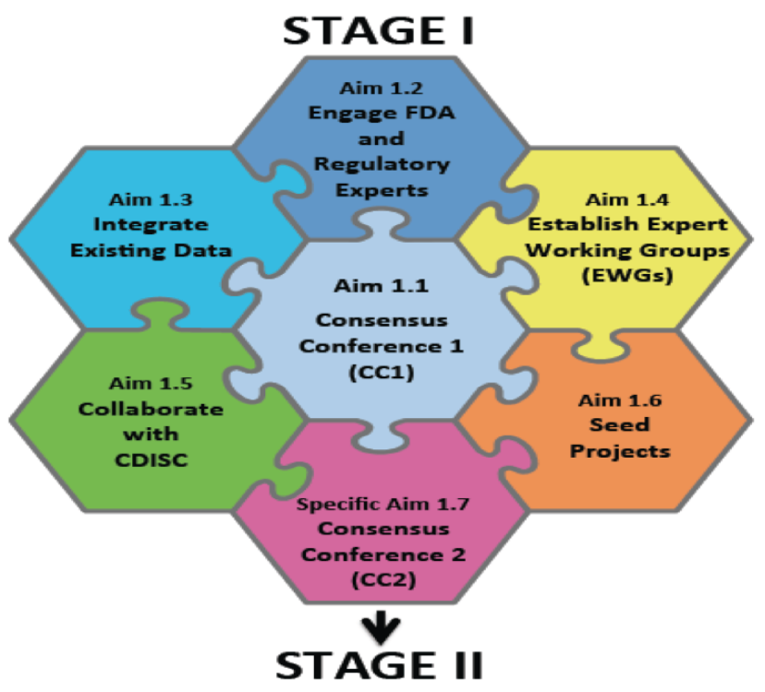
TED Aims:
Stage I
STAGE I Technical Objective 1:
Establish a collaborative, multidisciplinary team to:
Advance the identification and validation of clinical outcome assessments (COAs) and biomarkers for use as potential FDA-qualified drug development tools (DDTs)
Initiate development of CDISC data standards for trials involving diagnosis and treatment of mTBI to modTBI.
TBI Endpoints Development (TED) Project

Slide 5
Adult & Pediatric CDE Basic and Core Outcome Measures
Sub-Domain | Instrument/Scale | CDE Level
Global Outcome | GOS-E/GOS-E-Peds | Core
 | DRS | Basic
Adaptive and Daily Living Skills | FIM; WeeFIM/PEDI | Basic
Cognitive Activity Limitations | FIM-Cog | Basic
Language and Communication | WASI-II Vocabulary | Basic
Neuropsychological Impairment | Adult: WAIS-IV PSI; Trail Making Test; RAVLT/CVLT; Peds: WISC-IV/WPPSI-IV; D-KEFS Verbal Fluency | Basic
Perceived Health-Related Quality of Life | SWLS; Peds QoL Inventory (Generic) | Basic
Physical Function | FIM-Motor, Rivermead; Peds: WeeFIM-Motor/PEDI-Mobility | Basic
Psychiatric/Psychological Status | BSI-18 | Basic
Social Competence | CHART-SF | Basic

Slide 6


Objective 1.5
Collaborate with the Clinical Data Interchange Standards Consortium (CDISC) to conform TBI Common Data Elements (TBI-CDEs) to CDISC standards for FDA regulatory submission
CDISC: A global, open, multidisciplinary, non-profit organization that has established standards to support the acquisition, exchange, submission and archive of clinical research data and metadata.
Mission: To develop and support global, platform-independent data standards that enable information system interoperability to improve medical research and related areas of healthcare.

Slide 7
TED Aims:
Stage II
The Future of TBI Science
Multi-Dimensional Assessment of TBI Outcome
A Collaborative Effort of TRACK-TBI and TED
Global Function
Level
COMPOSITE OUTCOME INDEX
STAGE II Technical Objective: 2
Validate candidate COAs and biomarkers selected in Stage I, leveraging the existing research infrastructure and clinical study networks of TRACK-TBI, CENC, and CRC for potential qualification as DDTs
Clinical Phenotype Level
Cognitive
Domain
Neurobehavioral Domain
Psychological Health Domain
Quality of Life Domain
Physical Function Domain
Memory
Attention
Judgment
Impulse
Mood
Anxiety
PCS Sx’s
Life Satisf
Motor
Sensory
Skill Impairment
Level
Exec Func
Cog Proc
Anger
Disinhib
PTSD
Psychosis
Voc
Social
Percept
Mobility
Language
Vis-spat
Soc. Beh
Apathy
Personal
Locus of C
Financial
Recreat
Pain
Sleep
Intellig
Other
Other
Other
Other
Other
Other
Other
Other
Other
Source Variance
Level
Item Level Responses
Item Level Responses
Item Level Responses
Item Level Responses
Item Level Responses
Proposed Work Flow: TRACK-TBI and TED COA Working Groups lead and commission SME groups to refine the mutli-dimensional outcome model, and identify core measures in each domain for validation studies, leveraging NINDS CDE’s and existing literature.
Intended Work Product: empirically-based consensus recommendations on specific measures for TBI trials, and on concept of use (COU) (what measures to use based on acuity, population, setting, and form of intervention under study).
TBI Endpoints Development (TED) Project
McCrea, Giacino, Dikmen, Manley 2015

Slide 8
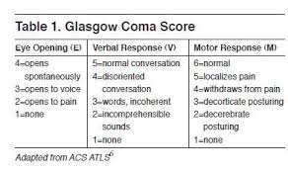
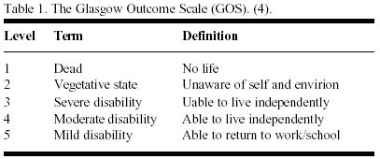
Current State of TBI Science

Slide 9
TED Metadataset
CENTER-TBI
COBRIT
CENC
LEARN
TRACK-TBI
UW
Army STARRS
TED
NCAA-
DOD
NCAA-
15 yeqr
Mission
Connect
CRC
GE-
NFL
ADAPT

Slide 10
Challenges
How do we integrate disparate datasets conceptually and technically?
What is the best approach to vetting the strength of COAs?
Which data analytic procedures are best suited to validating this novel approach to outcome assessment?

Slide 11
Opportunities
Exploit scope and depth of existing datasets
Pursue novel approach to outcome assessment that relies on multi-dimensional modeling of TBI outcomes
Develop COA platforms specific to particular TBI phenotypes
Synchronize new approach to outcome assessment with FDA COA qualification process to accelerate advances in TBI care

Slide 12













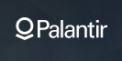

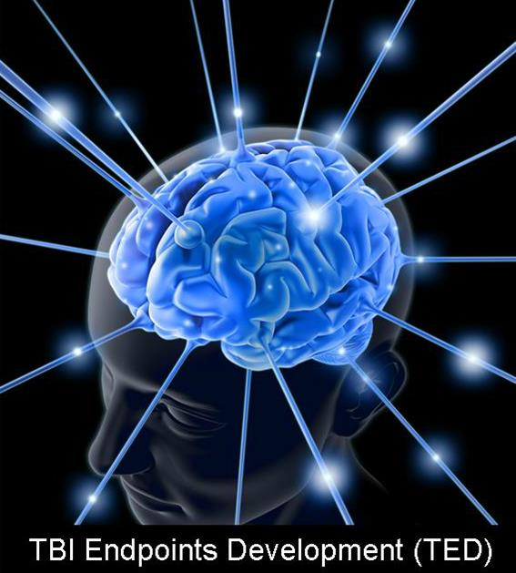

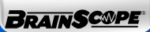





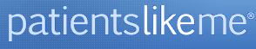












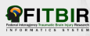





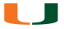








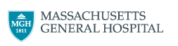



Public -Private Partnership
Private Partners
Not for Profit and Philanthropic Partners
Government Partners
TED
Academic Partners
Notes:
Move fro linear to parallel

Slide 13
“If you can’t win the game, you have to change the rules.”
Col. Dallas Hack, MD
Director, U.S. Army Combat Casualty Care Research Program
Exploiting the past to inform the future of clinical

